Slide 1
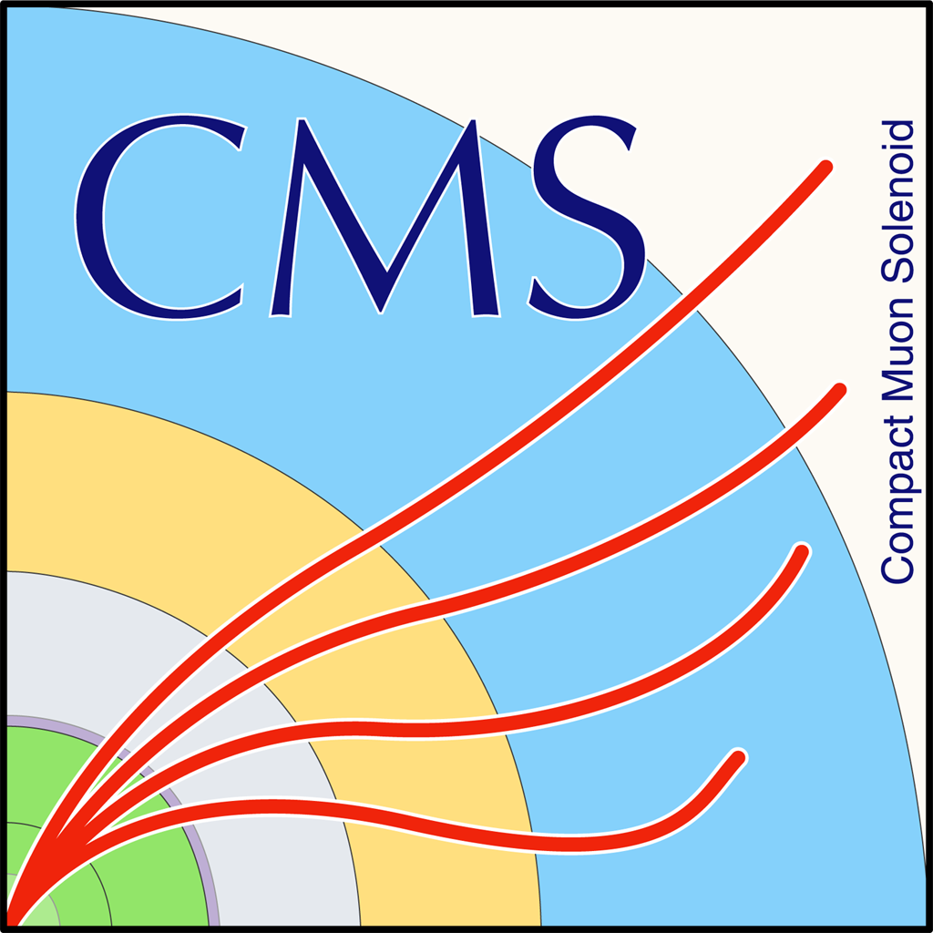

Status Report Mass Fit and bTagging Efficiency (2016 and 2017)
George Bakas, K.Kousouris, Ioannis Papakrivopoulos

Slide 2
Overview of Signal Region, Control Region and SR_{A} region
Signal Region (SR): Baseline Selection + topTagger Selection + mass Selection + 2btagged subjets
Control Region (CR): Baseline Selection + topTagger Selection + mass Selection + 0btagged subjets
Extension of Signal Region → SR_{A} = SR – Mass Selection cuts
Selection:
Jet Matching
Baseline Reconstructed level cuts:
nJets > 1
nLeptons = 0
Dijet mass (mJJ) > 1000
Leading and Subleading jet p_{T} > 400
Leading and Subleading absolute jet eta |η|<2.4
Trigger
Baseline Parton cuts:
partonPt[0],[1] > 400
|partonEta[0],[1]| < 2.4
mTTbarParton > 1000
Btagging selection:
bTagging (medium WP deepCSV) (2016: 0.6321, 2017: 0.4941, 2018: 0.4184)
Top Tagger:
Tagger cut (top Tagger) (2016: 0.2, 2017:0.0, 2018: 0.1)

Slide 3
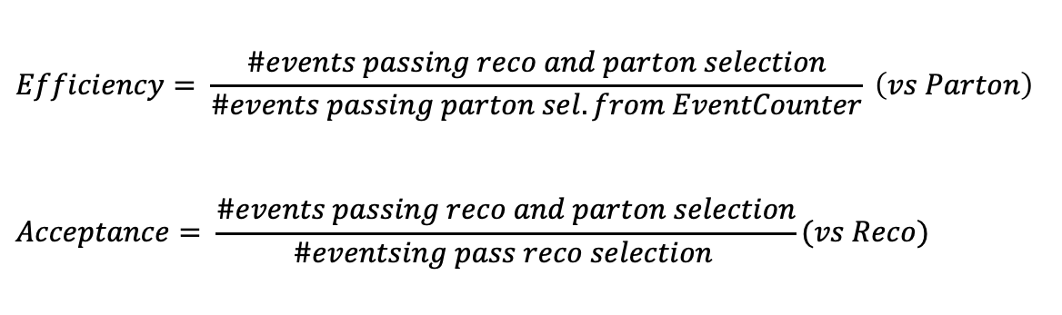
Overview Discriminator, Efficiency and Acceptance
The discriminator is a BDT trained individually for 2016, 2017 and 2018
Input variables:
jetTau (3,2,1),
Subjet mass
Energy Correlation functions
JetPt over Sum Pt: fraction of the jet Pt over the pt sum of all jets in the event
BDT Output consistency for the 3 years
Calculation of Efficiency and acceptance for each year
We choose the WP’s for each year so that the leading jet p_{T} efficiency is similar for all years
$$Efficiency= \frac{\#events passing reco and parton selection}{\#events passing parton sel. from EventCounter} \left(vs Parton\right)$$
$$Acceptance= \frac{\#events passing reco and parton selection}{\#eventsing pass reco selection }(vs Reco)$$

Slide 4
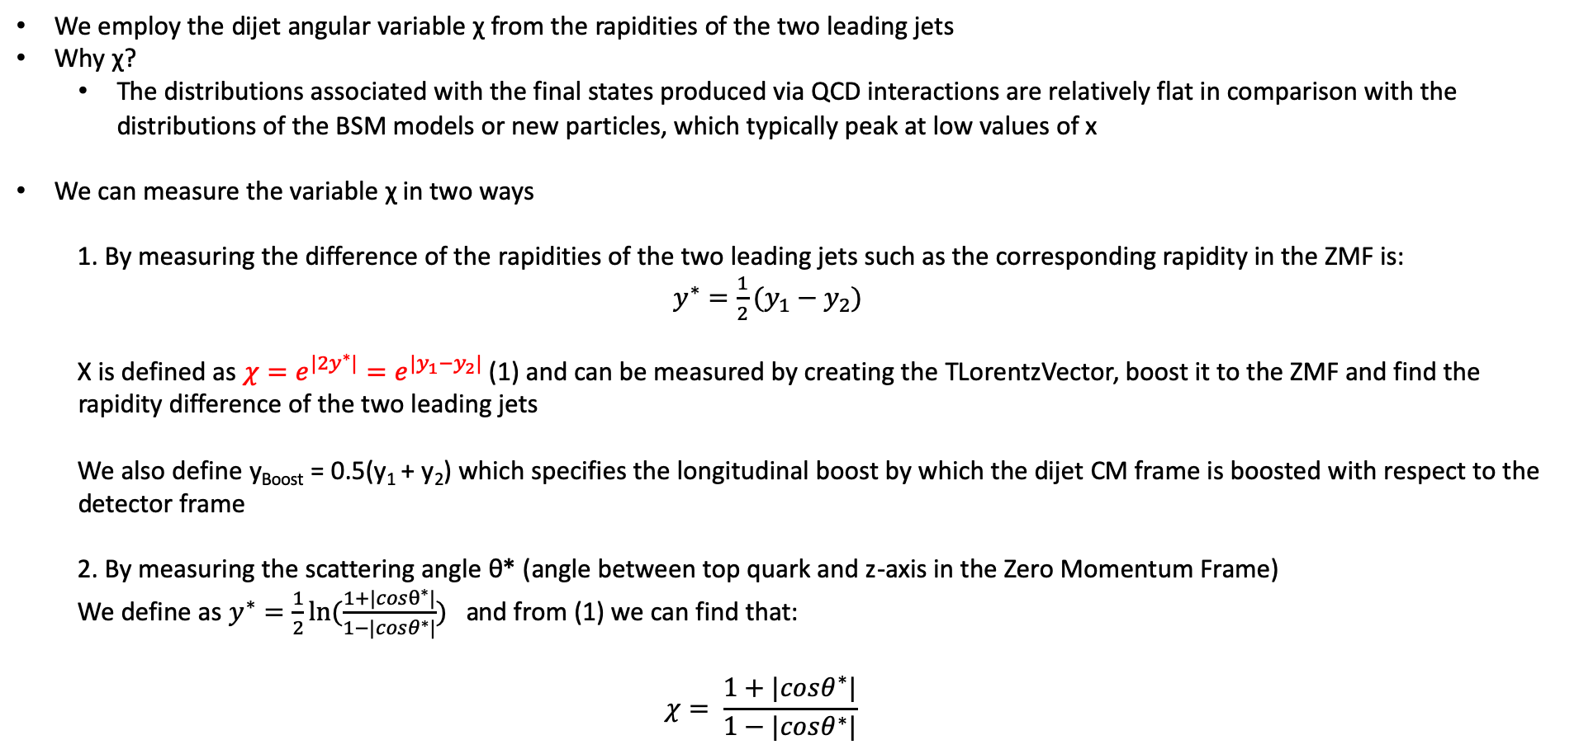
Angular Distributions
We employ the dijet angular variable χ from the rapidities of the two leading jets
Why χ?
The distributions associated with the final states produced via QCD interactions are relatively flat in comparison with the distributions of the BSM models or new particles, which typically peak at low values of x
We can measure the variable χ in two ways
1. By measuring the difference of the rapidities of the two leading jets such as the corresponding rapidity in the ZMF is: $y^{∗}=\frac{1}{2}(y_{1}−y_{2})$
Χ is defined as $χ=e^{{|2y}^{∗}|}=e^{|y_{1}−y_{2}|}$ (1) and can be measured by creating the TLorentzVector, boost it to the ZMF and find the rapidity difference of the two leading jets
We also define y_{Boost} = 0.5(y₁ + y₂) which specifies the longitudinal boost by which the dijet CM frame is boosted with respect to the detector frame
2. By measuring the scattering angle θ* (angle between top quark and z-axis in the Zero Momentum Frame)
We define as $y^{∗}=\frac{1}{2}ln⁡(\frac{1+|cosθ^{∗}|}{1−|cosθ^{∗}|})$ and from (1) we can find that:
$$χ= \frac{1+|cosθ^{∗}|}{1−|cosθ^{∗}|}$$

Slide 5
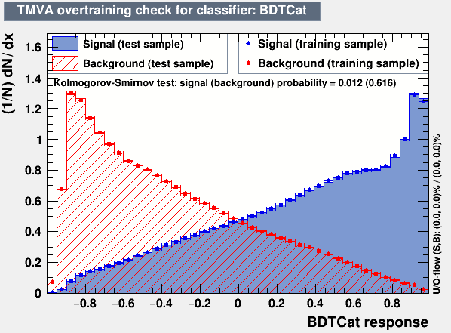
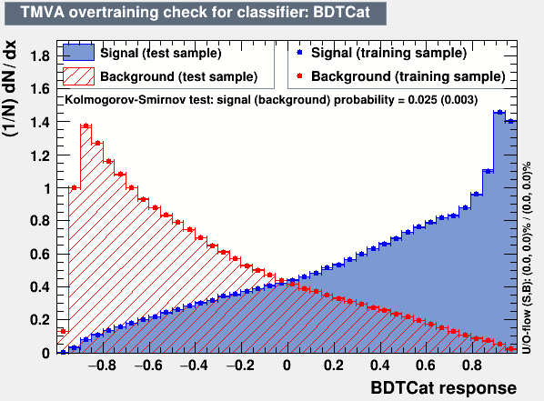
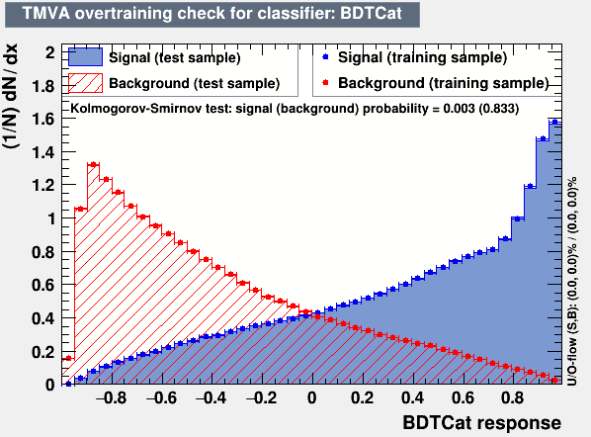
Training Outputs
2016
2017
2018

Slide 6
Efficiency and Acceptance for 2016, 2017 and 2018 and previous 2016 analysis

Slide 7
Btagging efficiency in eta, pT_{subJet} phase space
2016
2017

Slide 8
Btagging efficiency in eta, pT_{subJet} phase space
2018
2016

Slide 9
Efficiency, Acceptance for χ

Slide 10
Efficiency, Acceptance for |cos(θ*)|

Slide 11
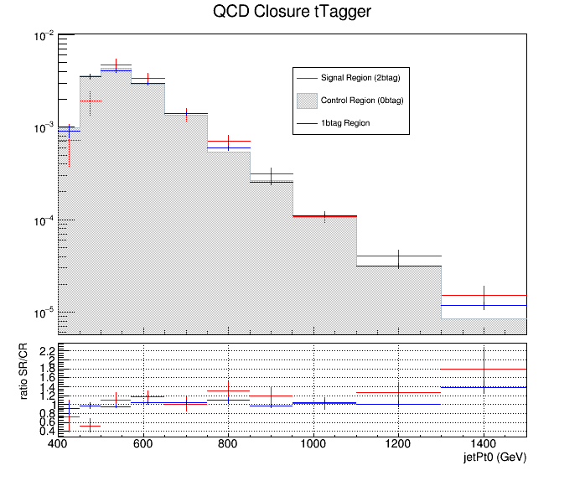
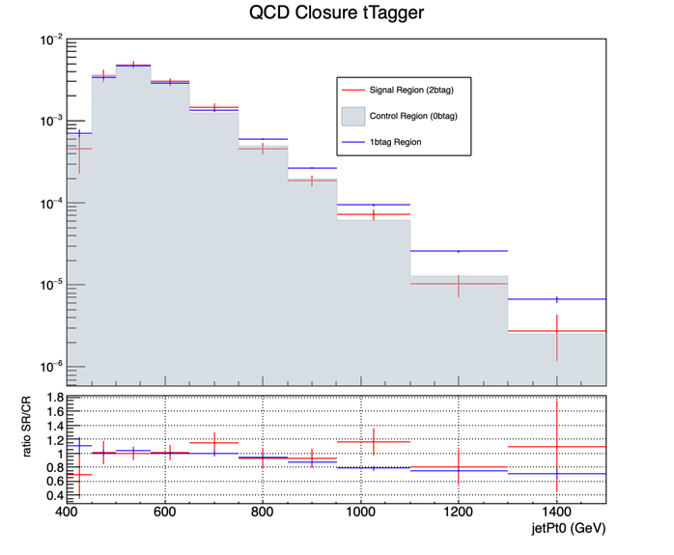
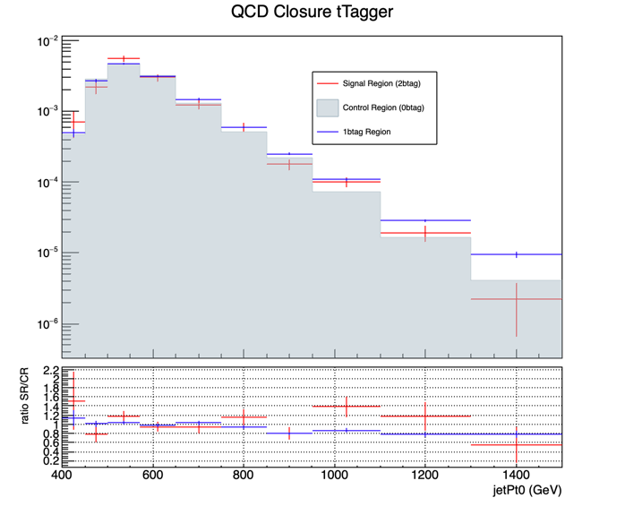
QCD Closure Tests ’16, ‘17, ’18 jetPt0
2016
2017
2018

Slide 12
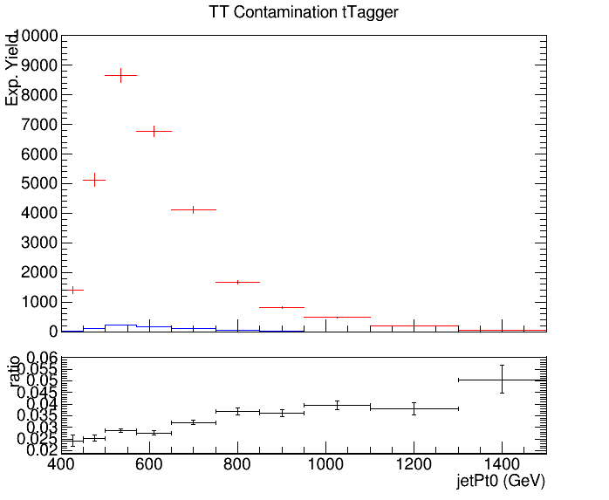
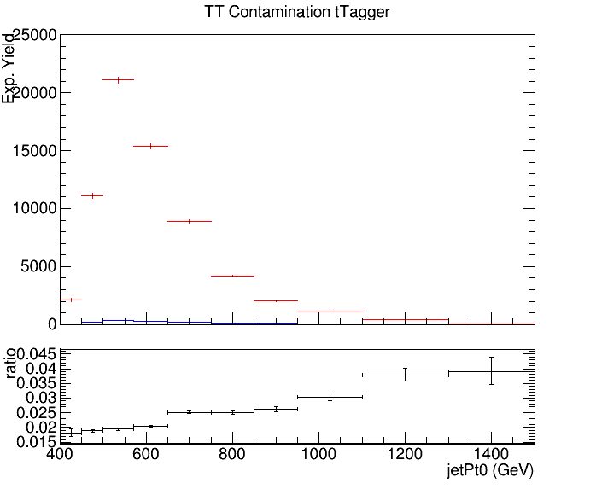
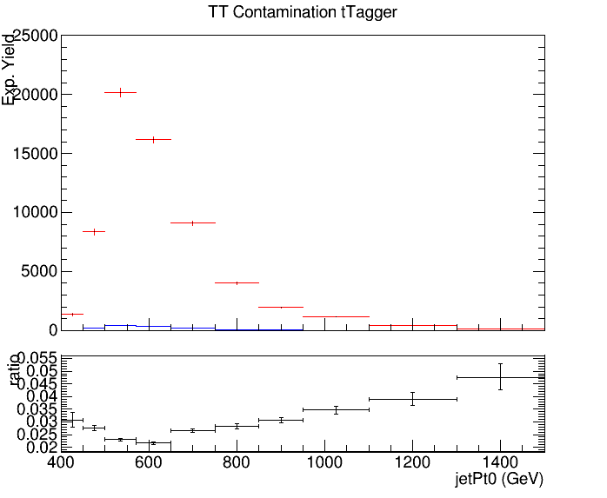
CR Contamination ’16,’17,’18 jetPt0
Control Region QCD sample
Control Region TT sample
2016
2017
2018

Slide 13
QCD Closure Tests ’16, ‘17, ’18 χ
2016
2017
2018

Slide 14
CR Contamination ’16,’17,’18 χ
Control Region QCD sample
Control Region TT sample
2016
2017
2018

Slide 15
QCD Closure Tests ’16, ‘17, ’18 |cos(θ*)|
2016
2017
2018

Slide 16
CR Contamination ’16,’17,’18 |cos(θ*)|
Control Region QCD sample
Control Region TT sample
2016
2017
2018

Slide 17
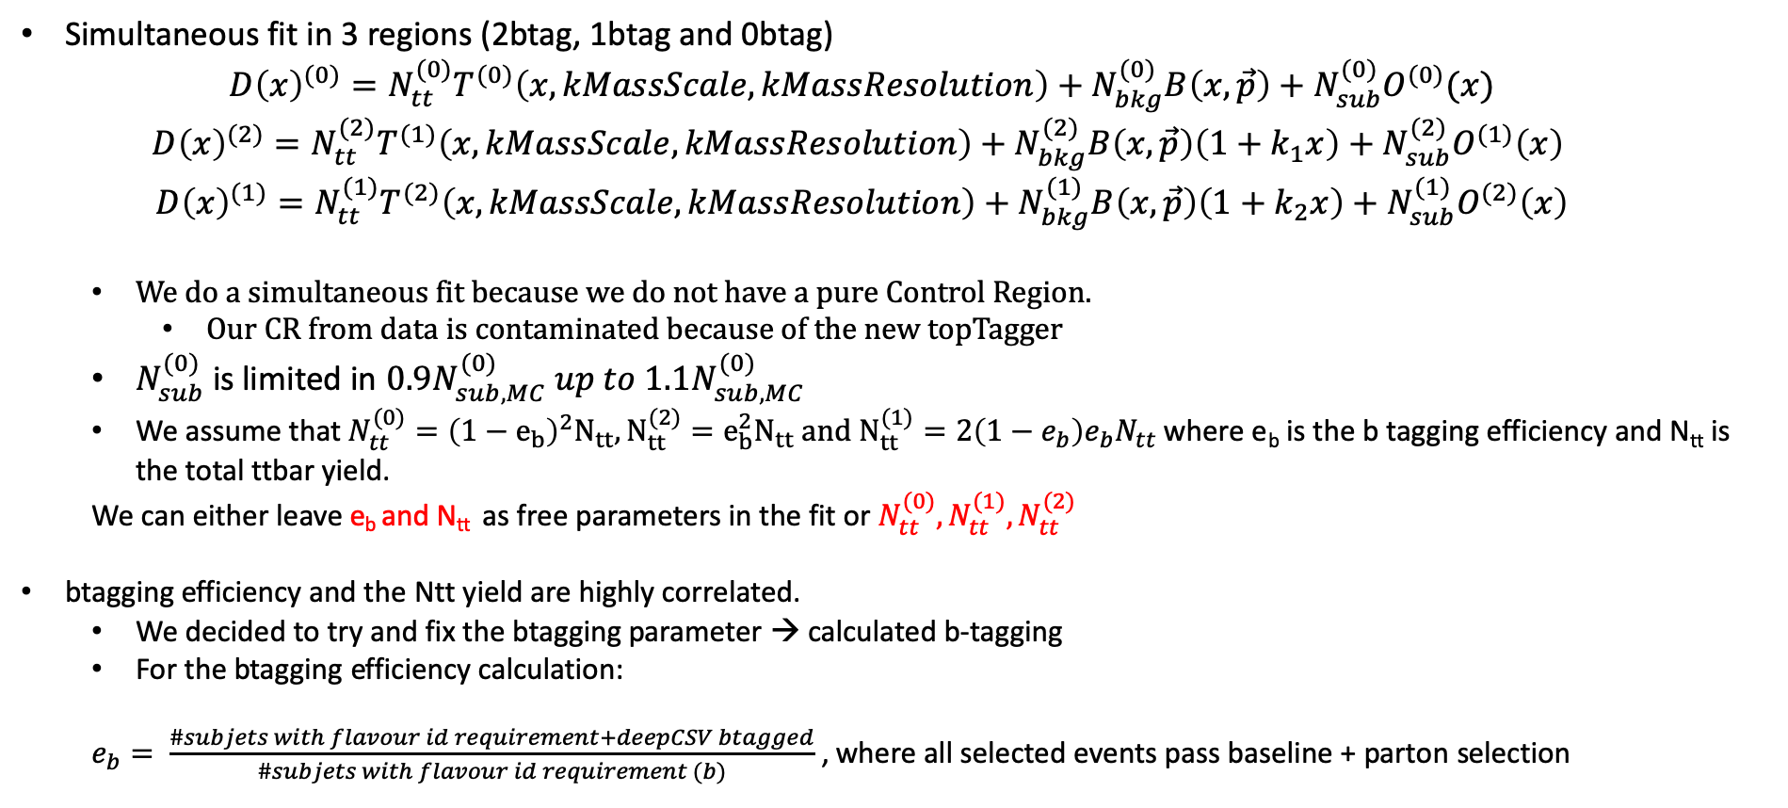
Simultaneous Fit in 3 regions
Simultaneous fit in 3 regions (2btag, 1btag and 0btag)
$$D{\left(x\right)}^{(0)}=N_{tt}^{(0)}T^{(0)}\left(x, kMassScale, kMassResolution\right)+N_{bkg}^{(0)}B\left(x,\vec{p}\right)+N_{sub}^{(0)}O^{(0)}(x)$$
$$D{\left(x\right)}^{(2)}=N_{tt}^{(2)}T^{(1)}\left(x,kMassScale, kMassResolution\right)+N_{bkg}^{(2)}B\left(x,\vec{p}\right)\left(1+k_{1}x\right)+N_{sub}^{(2)}O^{(1)}\left(x\right)$$
$$D{\left(x\right)}^{(1)}=N_{tt}^{(1)}T^{(2)}\left(x,kMassScale, kMassResolution\right)+N_{bkg}^{(1)}B\left(x,\vec{p}\right)\left(1+k_{2}x\right)+N_{sub}^{(1)}O^{(2)}\left(x\right)$$
We do a simultaneous fit because we do not have a pure Control Region.
Our CR from data is contaminated because of the new topTagger
$N_{sub}^{(0)}$ is limited in $0.9N_{sub,MC}^{(0)} up to 1.1N_{sub,MC}^{(0)}$
We assume that $N_{tt}^{(0)}={\left(1−e_{b}\right)}^{2}N_{tt}, N_{tt}^{(2)}=e_{b}^{2}N_{tt} and N_{tt}^{(1)}=2\left(1−e_{b}\right)e_{b}N_{tt}$ where e_{b} is the b tagging efficiency and N_{tt} is the total ttbar yield.
We can either leave e_{b} and N_{tt} as free parameters in the fit or $N_{tt}^{(0)},N_{tt}^{(1)},N_{tt}^{(2)}$
btagging efficiency and the Ntt yield are highly correlated.
We decided to try and fix the btagging parameter → calculated b-tagging
For the btagging efficiency calculation:
$e_{b}= \frac{\#subjets with flavour id requirement+deepCSV btagged}{\#subjets with flavour id requirement (b)}$ , where all selected events pass baseline + parton selection

Slide 18
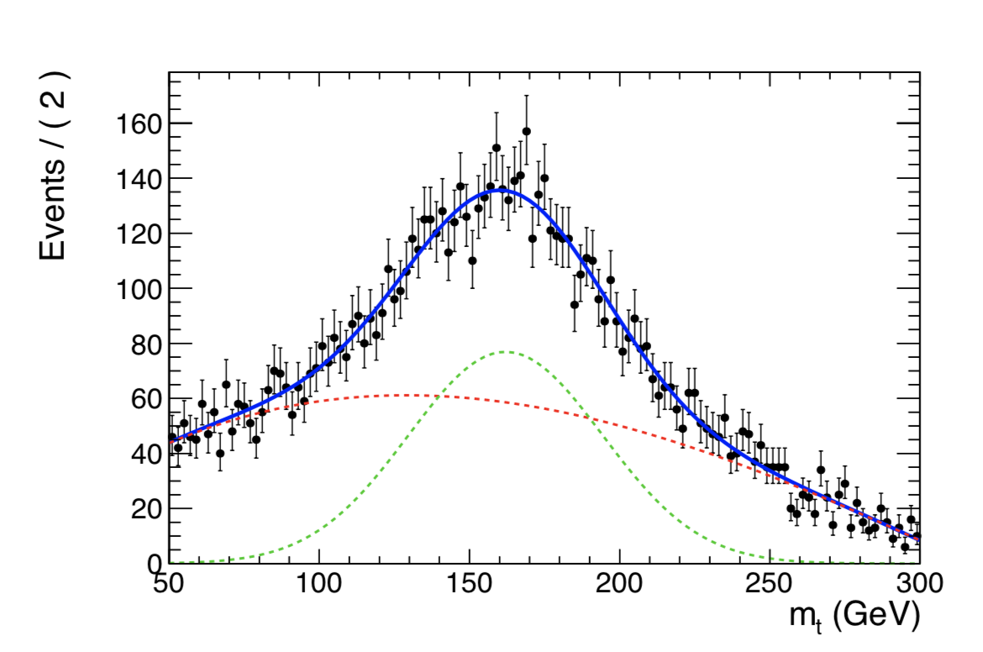
Template Fit results in CR
2016
2016
2017
2018

Slide 19
We are checking for different values of e_{b} , the output of the N⁽²⁾_{QCD} for 2016 and 2017
Points of interest are from 0.4 - 0.8 but especially 0.5-0.7 for 2016 and 0.45-0.6 5 for 2017
Calculated btagging efficiency for both years
btagging efficiency when the parameter is set as a free nuisance in the simultaneous fit
2016: eb (fit) ≈ 0.56 and eb (calculated) ≈0.63
2017: eb(fit) ≈ 0.48 and eb (calculated) ≈ 0.61
2018: eb(fit) ≈ 0.52 and eb (calculated) ≈ 0.63

Slide 20
Simultaneous Fit in 3 regions for 2017 and 2016 when eb is free
Signal Region (2btag) (2017)
Signal Region (2btag) (2016)
Result of the template fit on data in SR. The red line shows the ttbar contribution, the green line shows the QCD, and the brown line shows the subdominant backgrounds

Slide 21
Simultaneous Fit in 3 regions for 2017 and 2016 when eb is free
Control Region (0btag) (2017)
Control Region (0btag) (2016)
Result of the template fit on data in CR. The red line shows the tt contribution, the green line shows the QCD, and the brown line shows the subdominant backgrounds

Slide 22
Simultaneous Fit in 3 regions for 2017 and 2016 (1btag Region)
2017
2016

Slide 23
Simultaneous Fit in 3 regions for 2017 and 2018 when eb is free
Signal Region (2btag) (2017)
Signal Region (2btag) (2018)
Result of the template fit on data in SR. The red line shows the ttbar contribution, the green line shows the QCD, and the brown line shows the subdominant backgrounds

Slide 24
Simultaneous Fit in 3 regions for 2017 and 2018 when eb is free
Control Region (0btag) (2017)
Control Region (0btag) (2018)
Result of the template fit on data in CR. The red line shows the tt contribution, the green line shows the QCD, and the brown line shows the subdominant backgrounds

Slide 25
Simultaneous Fit in 3 regions for 2017 and 2018 (1btag Region)
2017
2018

Slide 26
Simultaneous Fit in 3 regions for 2016 ,2017 and 2018 (nuisances)
2016
2017
2018
Floating Parameter FinalValue +/- Error
-------------------- --------------------------
btagEff 5.6029e-01 +/- 1.17e-02
kMassResol 9.6557e-01 +/- 2.29e-02
kMassScale 1.0020e+00 +/- 1.60e-03
kQCD_1b 5.8296e-03 +/- 4.50e-04
kQCD_2b 7.7313e-02 +/- 4.98e-02
nFitBkg_0b 4.5269e+03 +/- 5.63e+01
nFitBkg_1b 2.3159e+03 +/- 4.02e+02
nFitBkg_2b 2.3726e+02 +/- 4.25e+01
nFitQCD_0b 8.7019e+04 +/- 4.15e+02
nFitQCD_1b 2.8973e+04 +/- 3.93e+02
nFitQCD_2b 2.9980e+03 +/- 1.43e+02
nFitSig 1.6686e+04 +/- 6.56e+02
Floating Parameter FinalValue +/- Error
-------------------- --------------------------
btagEff 4.8200e-01 +/- 1.08e-02
kMassResol 1.0643e+00 +/- 2.78e-02
kMassScale 9.8669e-01 +/- 1.87e-03
kQCD_1b 4.3736e-03 +/- 3.14e-04
kQCD_2b 1.3374e-02 +/- 4.41e-03
nFitBkg_0b 4.0852e+03 +/- 6.06e+01
nFitBkg_1b 2.0763e+03 +/- 3.69e+02
nFitBkg_2b 2.1330e+02 +/- 4.69e+01
nFitQCD_0b 1.5273e+05 +/- 5.71e+02
nFitQCD_1b 3.4635e+04 +/- 4.31e+02
nFitQCD_2b 2.3896e+03 +/- 1.36e+02
nFitSig 1.9783e+04 +/- 7.97e+02
Floating Parameter FinalValue +/- Error
-------------------- --------------------------
btagEff 5.1228e-01 +/- 1.08e-02
kMassResol 1.0730e+00 +/- 2.43e-02
kMassScale 9.8917e-01 +/- 1.69e-03
kQCD_1b 3.5721e-03 +/- 7.53e-04
kQCD_2b 1.2218e-02 +/- 2.77e-03
nFitBkg_0b 4.1842e+03 +/- 4.92e+01
nFitBkg_1b 2.5677e+03 +/- 2.98e+02
nFitBkg_2b 4.1750e+02 +/- 7.27e+01
nFitQCD_0b 1.6558e+05 +/- 6.68e+02
nFitQCD_1b 4.5743e+04 +/- 2.78e+03
nFitQCD_2b 4.2092e+03 +/- 1.42e+02
nFitSig 2.9030e+04 +/- 1.40e+03
Ntt expected = 16351.2
Ntt observed = 16685.5
r = 1.02045
Ntt expected = 23720.7
Ntt observed = 19782.6
r = 0.833981
Ntt expected = 30676.2
Ntt observed = 29030.2
r = 0.94634

Slide 27
BACKUP SLIDES

Slide 28
Btagging purity
2016
2017
2018
Purity ≈ 0. 894
Purity ≈ 0.915
Purity ≈ 0.903

Slide 29
2016
2017
2018

Slide 30
Correlation plots N_{QCD(2)} vs all nuisances from fit when eb runs free for 2016

Slide 31
Correlation plots N_{QCD(2)} vs all nuisances from fit when eb runs free for 2016

Slide 32
Correlation plots N_{QCD(2)} vs all nuisances from fit when eb runs free for 2017

Slide 33
Correlation plots N_{QCD(2)} vs all nuisances from fit when eb runs free for 2017

Slide 34
Correlation plots N_{QCD(2)} vs all nuisances from fit when eb runs free for 2018

Slide 35
Correlation plots N_{QCD(2)} vs all nuisances from fit when eb runs free for 2018

Slide 36
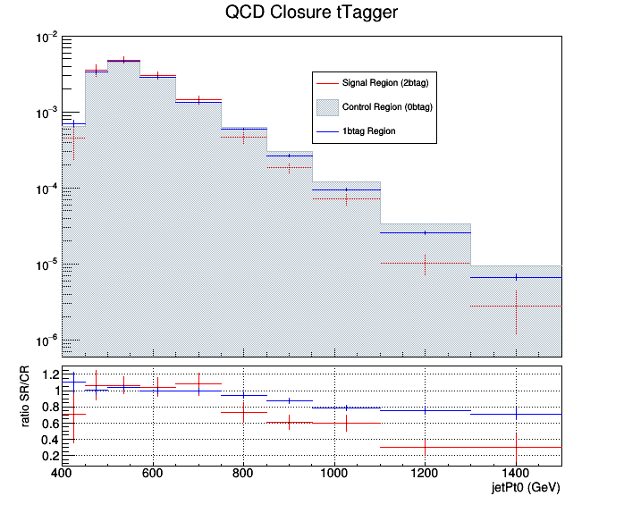
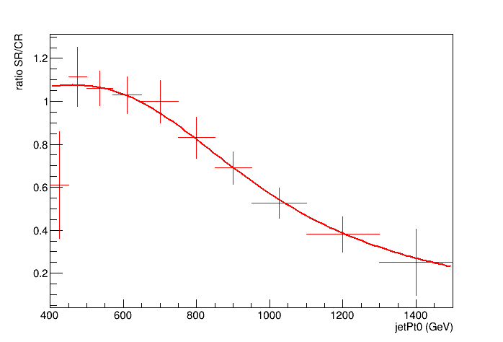
2017 QCD Closure and the fit ratio
Discovered shape in the SR/CR
Fit the ratio with the function:
Output of the new QCD closure

Slide 37
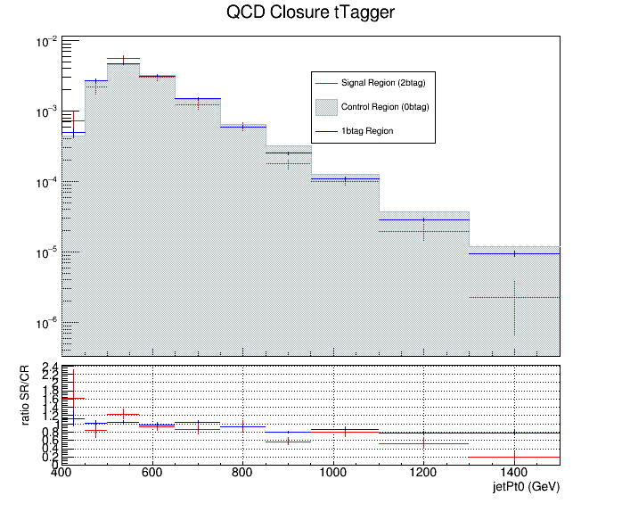
2018 QCD Closure and the fit ratio
Discovered shape in the SR/CR
Fit the ratio with the function:
Output of the new QCD closure

